Slide 1

Analyzing the Index of Economic Freedom
ANALYTICAL METHODS I
CORY BOYKO, SANA CHOPRA, OCTAVIO MEDINA PEDREIRA AND NHAT DUY PHAM

Slide 2
What is the Economic Freedom Index?
List of scores given annually by the Heritage Foundation to measure how "free" a country is economically
The Heritage Foundation describes economic freedom as "the fundamental right of every human to control his or her own labor and property." ("About the Index", n.d)
Covers four main topics: Rule of Law, Government Size, Regulatory Efficiency, and Open Markets ("About the Index", n.d)
33 variables (12 scores) with 179 observations (countries)
Each score is given equal weight ("About the Index", n.d)

Slide 3
Set Variables - Scores
Property Rights
Business Freedom
Government Spending
Trade Freedom
2019 Score
Fiscal Health
Judicial Effectiveness
Investment Freedom
Monetary Freedom
Tax Burden
Labor Freedom
Government Integrity
Financial Freedom

Slide 4
Set Variables - Financial & Country Info
Region World Rank Region Rank Tariff Rate Income Tax Rate
Corporate Tax Rate Tax Burden(% of GDP) Govt Expenditure(% of GDP)
Population GDP GDP Growth Rate 5 Year GDP Growth Rate
GDP per Capita Unemployment Inflation FDI Inflow
Public Debt(% of GDP)

Slide 5
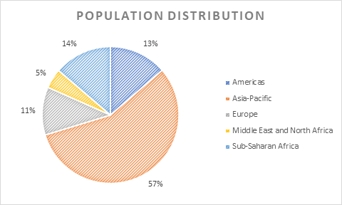
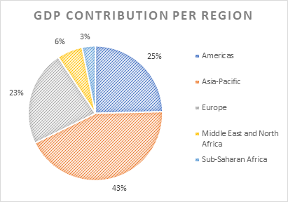
Descriptive Analysis
Americas and Europe contribute to almost 50% of world GDP although they account for only 24% of world population.

Slide 6
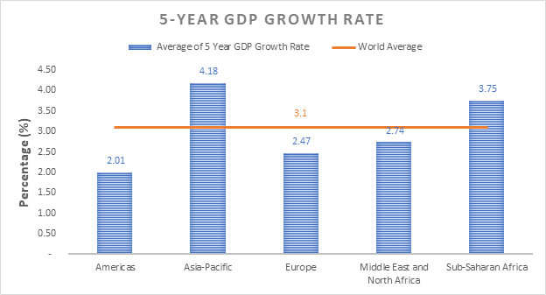
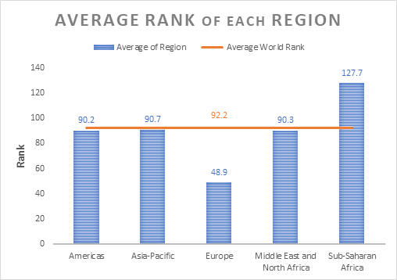
Descriptive Analysis
Asia-Pacific and Sub-Saharan Africa have higher 5-year GDP growth rates than the rest of the world.
Europe has a far better average rank while Sub-Saharan Africa has a far worse rank.

Slide 7
Research Question
Can we predict the 2019 Score, which is an average of the other scores, from the more general economic data?
The overall score is created from other "made up" scores, but is it related to economic data that businesses and countries use more commonly?
Can a country affect its score by changing other economic data
Variables Used: Region, Tariff Rate, Income Tax Rate, Corporate Tax Rate, Tax Burden (% of GDP), Govt Expenditure (% of GDP), Population, GDP, GDP Growth Rate, 5 Year GDP Growth Rate, GDP per capita, Unemployment, Inflation, FDI Inflow, Public Debt
Variables Not Used: Individual category scores – 2019 Score is an average of them, so naturally they would be able to predict the 2019 score

Slide 8
Can we predict the 2019 Score from general economic data?
We used the p-value method of Linear Regression
First, we started with all the variables and they were removed in the following order
1.) Population 2.) Region 3.)GDP Growth Rate 4.)Unemployment
5.) Public Debt 6.)Income Tax Rate 7.) Corporate Tax Rate
Final variables we are left with: Tariff Rate, Tax Burden (% of GDP), Govt Expenditure (% of GDP), GDP, 5 Year GDP Growth Rate, GDP per Capita, Inflation, FDI Inflow

Slide 9
Final Model
Y = 60.77 - 0.56(Tariff Rate) + 0.24(Tax Burden % of GDP) - 0.20(Govt Expenditure % of GDP)
- 0.00073(GDP) + 0.49(5 Year GDP Growth Rate) + 0.00021(GDP per Capita)
- 0.26(Inflation) + 0.000087(FDI Inflow)
R-squared: 0.6272

Slide 10
Correlations
Next, was to check that nothing was collinear
Govt Expenditure Percent of GDP GDP 2019 Score 0.06538966 0.11485117 Tariff Rate -0.20176665 -0.12707608 Tax Burden Percent of GDP 0.56872764 0.01282354 Govt Expenditure Percent of GDP 1.00000000 0.03214993 GDP 0.03214993 1.00000000 5 Year GDP Growth Rate -0.28883772 0.05807081 GDP per Capita 0.23924055 0.13743915 Inflation -0.25085922 -0.06057261 FDI Inflow 0.02873193 0.81301899
5 Year GDP Growth Rate GDP per Capita 2019 Score -0.034653985 0.6645405 Tariff Rate 0.011929873 -0.4677639 Tax Burden Percent of GDP -0.296359833 0.2867490 Govt Expenditure Percent of GDP -0.288837720 0.2392405 GDP 0.058070813 0.1374392 5 Year GDP Growth Rate 1.000000000 -0.2560151 GDP per Capita -0.256015141 1.0000000 Inflation 0.064764401 -0.2930899 FDI Inflow -0.007565641 0.2861870
2019 Score Tariff Rate 2019 Score 1.00000000 -0.56939471 Tariff Rate -0.56939471 1.00000000 Tax Burden Percent of GDP 0.34432114 -0.34159595 Govt Expenditure Percent of GDP 0.06538966 -0.20176665 GDP 0.11485117 -0.12707608 5 Year GDP Growth Rate -0.03465399 0.01192987 GDP per Capita 0.66454051 -0.46776392 Inflation -0.36565633 0.26249495 FDI Inflow 0.29525784 -0.20068463
Tax Burden Percent of GDP 2019 Score 0.34432114 Tariff Rate -0.34159595 Tax Burden Percent of GDP 1.00000000 Govt Expenditure Percent of GDP 0.56872764 GDP 0.01282354 5 Year GDP Growth Rate -0.29635983 GDP per Capita 0.28674898 Inflation -0.23605508 FDI Inflow 0.06984917
Inflation FDI Inflow 2019 Score -0.36565633 0.295257837 Tariff Rate 0.26249495 -0.200684627 Tax Burden Percent of GDP -0.23605508 0.069849168 Govt Expenditure Percent of GDP -0.25085922 0.028731928 GDP -0.06057261 0.813018995 5 Year GDP Growth Rate 0.06476440 -0.007565641 GDP per Capita -0.29308986 0.286187009 Inflation 1.00000000 -0.097861192 FDI Inflow -0.09786119 1.000000000
Nothing was collinear!

Slide 11
Residuals
- Next we consider whether the assumptions for the linear model hold in our case. For this we have to check whether:
The residuals of the model are normal
The variance of the residuals does not change too much
The residuals are independent
Each predictor variable in the model is linearly related to the response variable

Slide 12
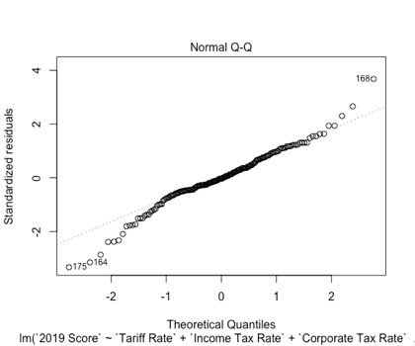
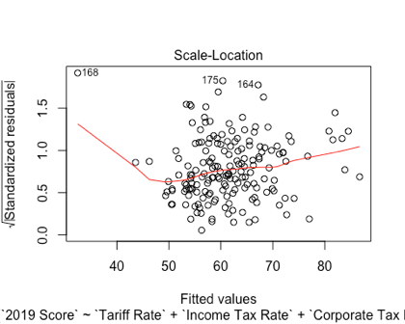
Residuals
Normality of Residuals
Variability of Residuals

Slide 13
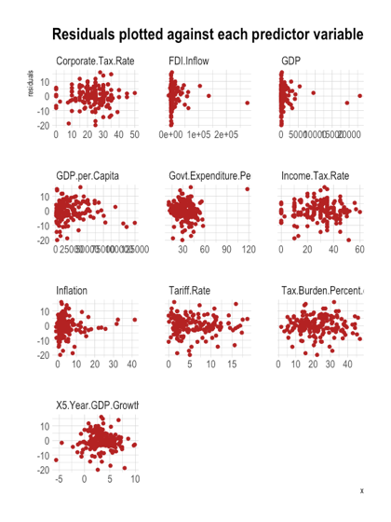
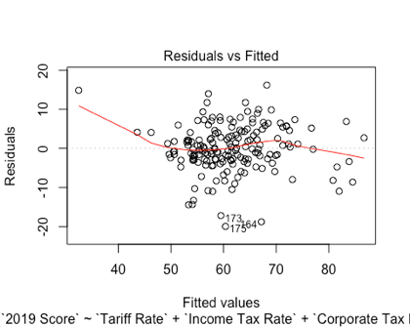
Residuals
Linearity of Residuals (in general and for all predictor variables)

Slide 14
Conclusions
The final model has a strong R-Squared of 0.6272 with 8 variables
Each of the values appear to be practically significant as well as statistically significant, based off of the magnitudes of each variable
A country's government can actively increase/decrease the predictive variables (as opposed to other ones such as their Region, population, etc.)

Slide 15
Further Research
Our data only included 2019 data, so the results should try to be reproduced with other years' data
If it cannot be reproduced, it would be interesting to see which models are best for other years
Is there more advanced economic statistics that can also be used to predict the score?
Now that we have a model, we can use it to 2020 scores to see how well it predicts overall score when their data changes
Is the model similar for the individual scores?

Slide 16
Sources
About The Index. (n.d). Retrieved from https://www.heritage.org/index/about.

